Slide 1
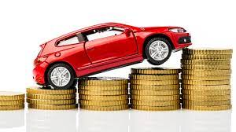
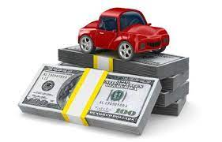
Car Price Prediction
By
Manoj.I.V,
Datatrained, Filiprobo Technologies

Slide 2
Problem statement
CAR PRICE PREDICTION
With the covid 19 impact in the market, we have seen lot of changes in the car market. Now some cars are in demand hence making them costly and some are not in demand hence cheaper. One of our clients works with small traders, who sell used cars. With the change in market due to covid 19 impact, our client is facing problems with their previous car price valuation machine learning models. So, they are looking for new machine learning models from new data. We have to make car price valuation model. This project contains two phase-
Data Collection Phase
You have to scrape at least 5000 used cars data. You can scrape more data as well, it’s up to you. more the data better the model
In this section You need to scrape the data of used cars from websites (Olx, cardekho, Cars24 etc.) You need web scraping for this. You have to fetch data for different locations. The number of
columns for data doesn’t have limit, it’s up to you and your creativity. Generally, these columns are Brand, model, variant, manufacturing year, driven kilometers, fuel, number of owners, location and at last target variable Price of the car. This data is to give you a hint about important variables in used car model. You can make changes to it, you can add or you can remove some columns, it completely depends on the website from which you are fetching the data.
Try to include all types of cars in your data for example- SUV, Sedans, Coupe, minivan, Hatchback.

Slide 3
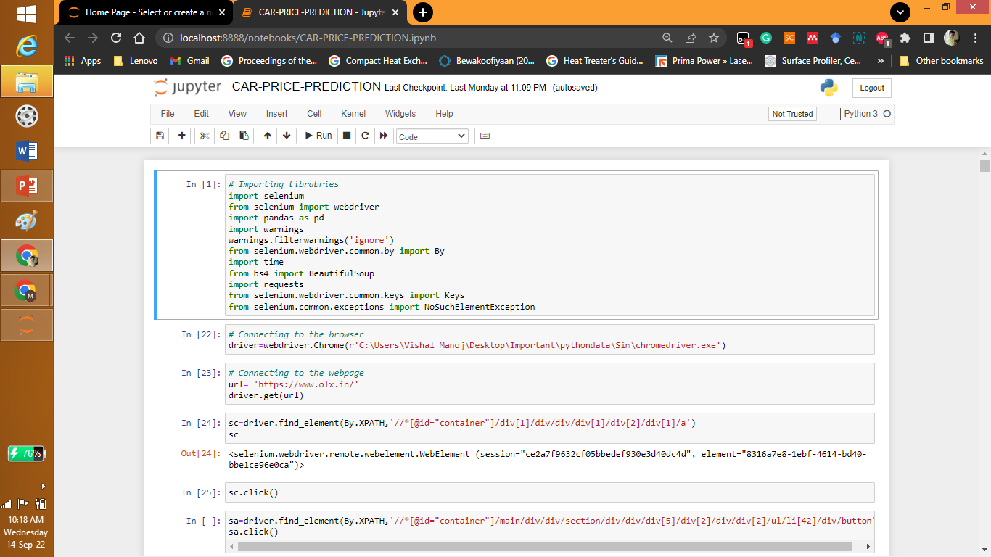
WEBSCRAPPING

Slide 4
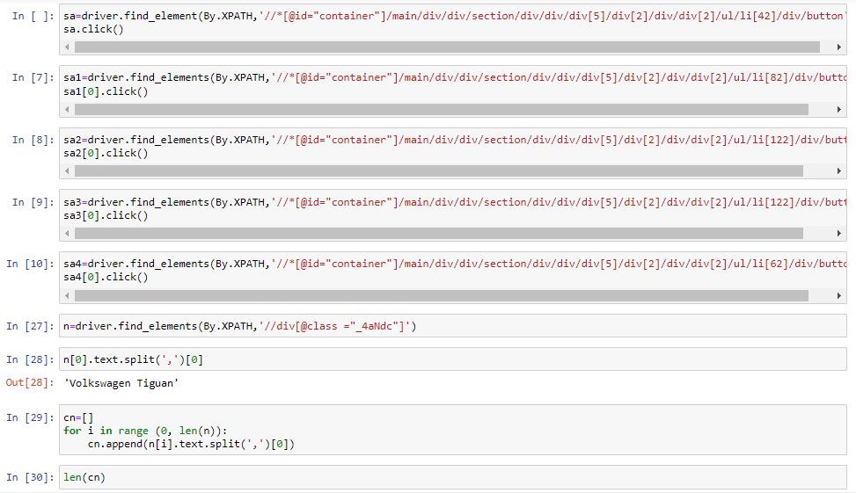
WEBSCRAPPING

Slide 5
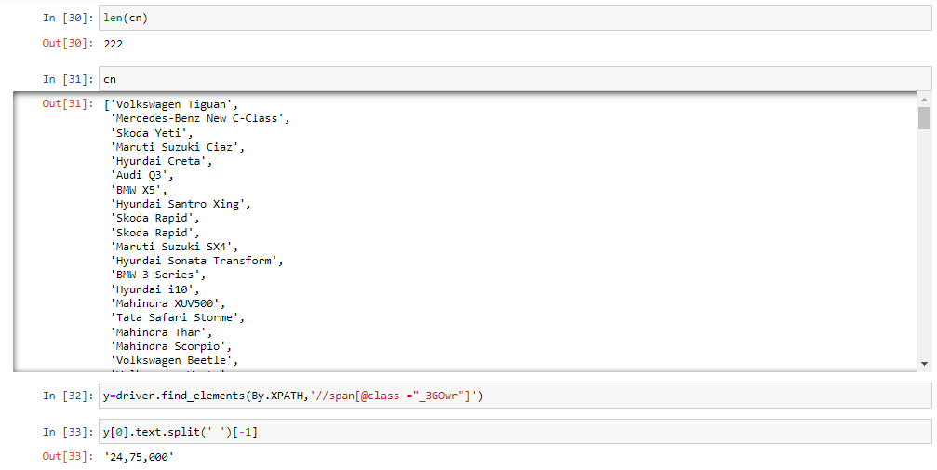
WEBSCRAPPING

Slide 6
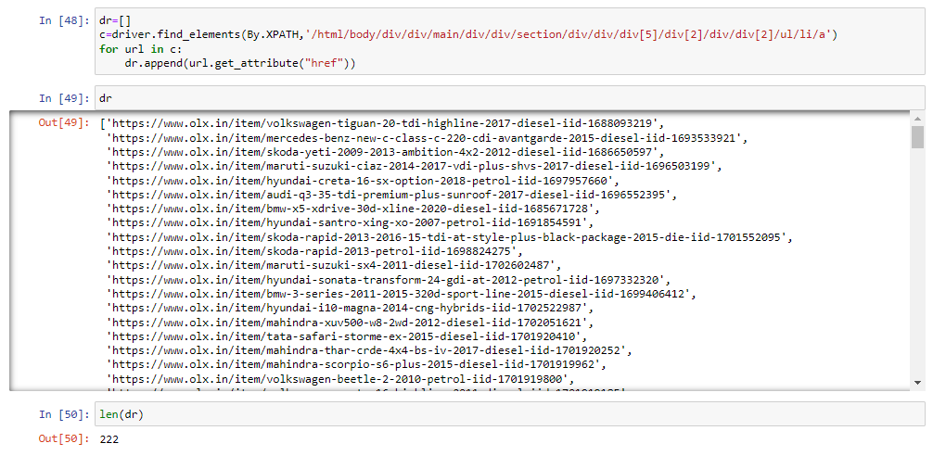
WEBSCRAPPING

Slide 7
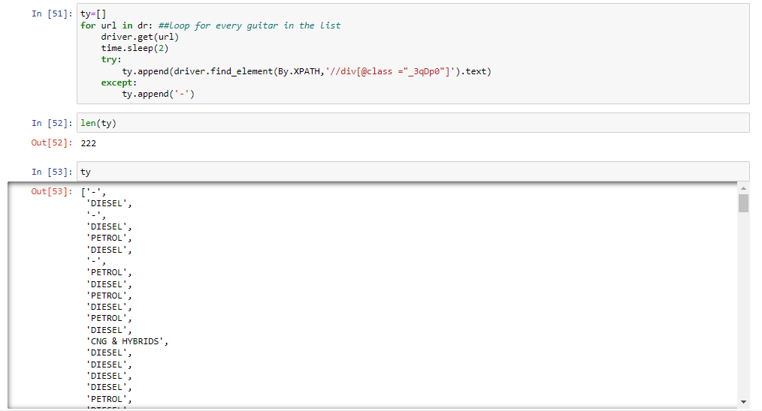
WEBSCRAPPING

Slide 8
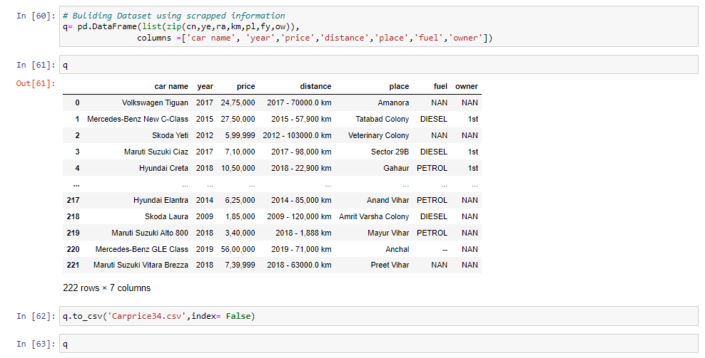
Dataset after scraping

Slide 9
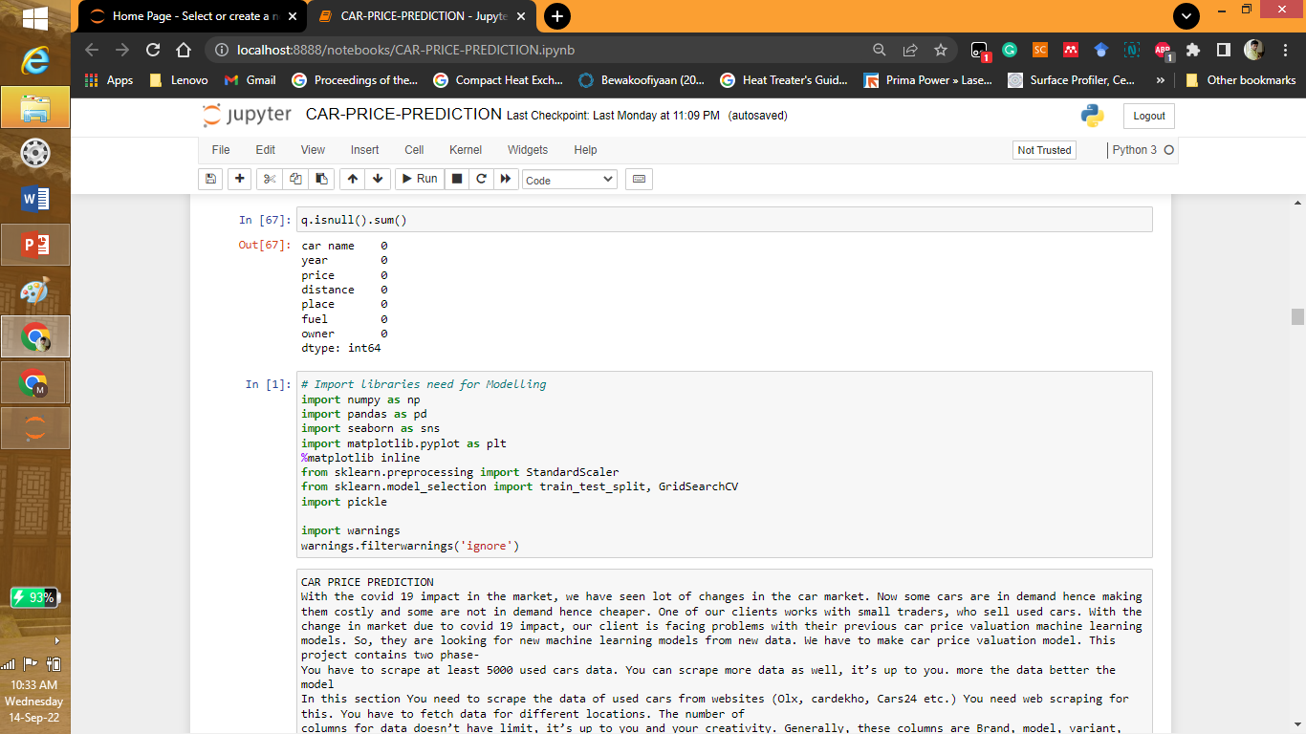
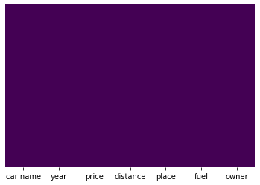
Importing libraries for data cleaning

Slide 10
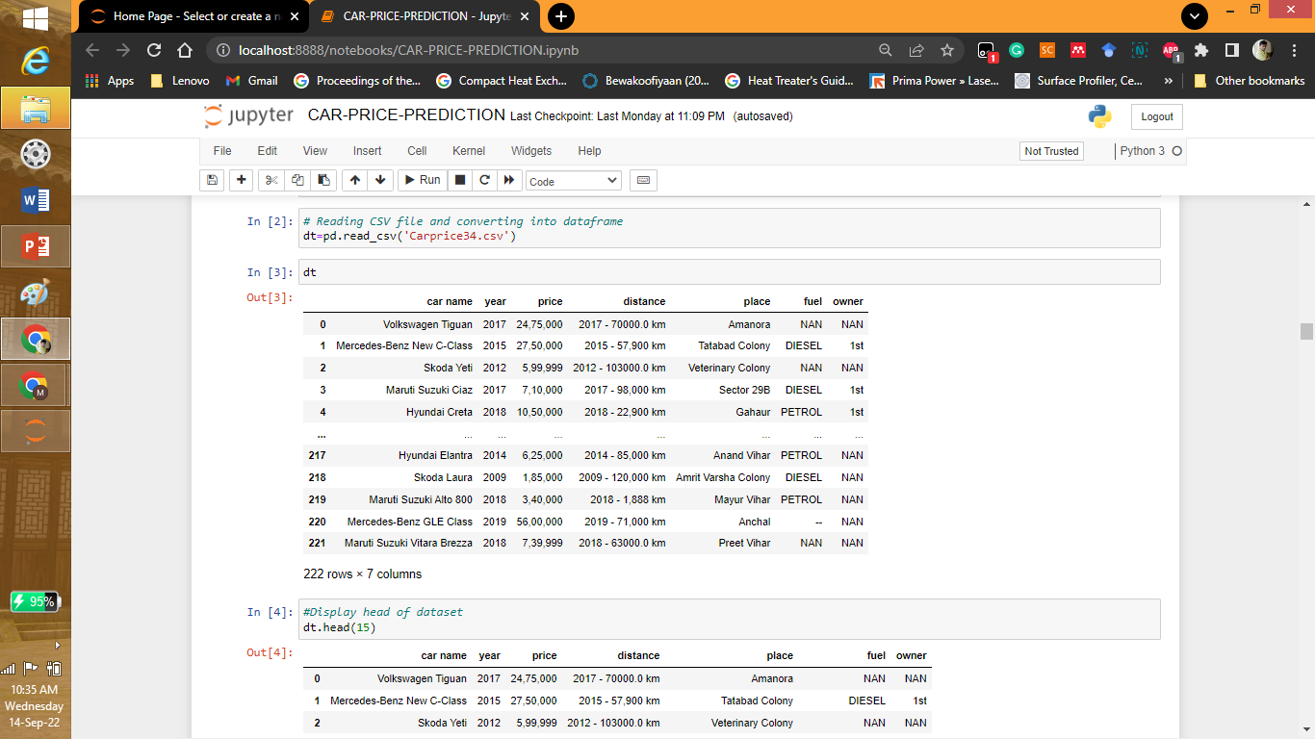

Analysis of Dataset

Slide 11
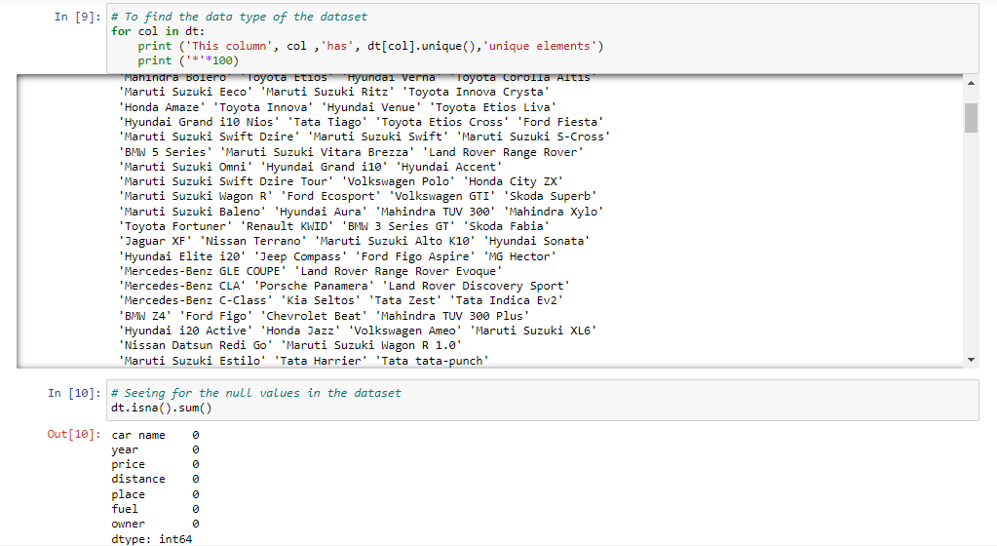
Analysis of Dataset

Slide 12
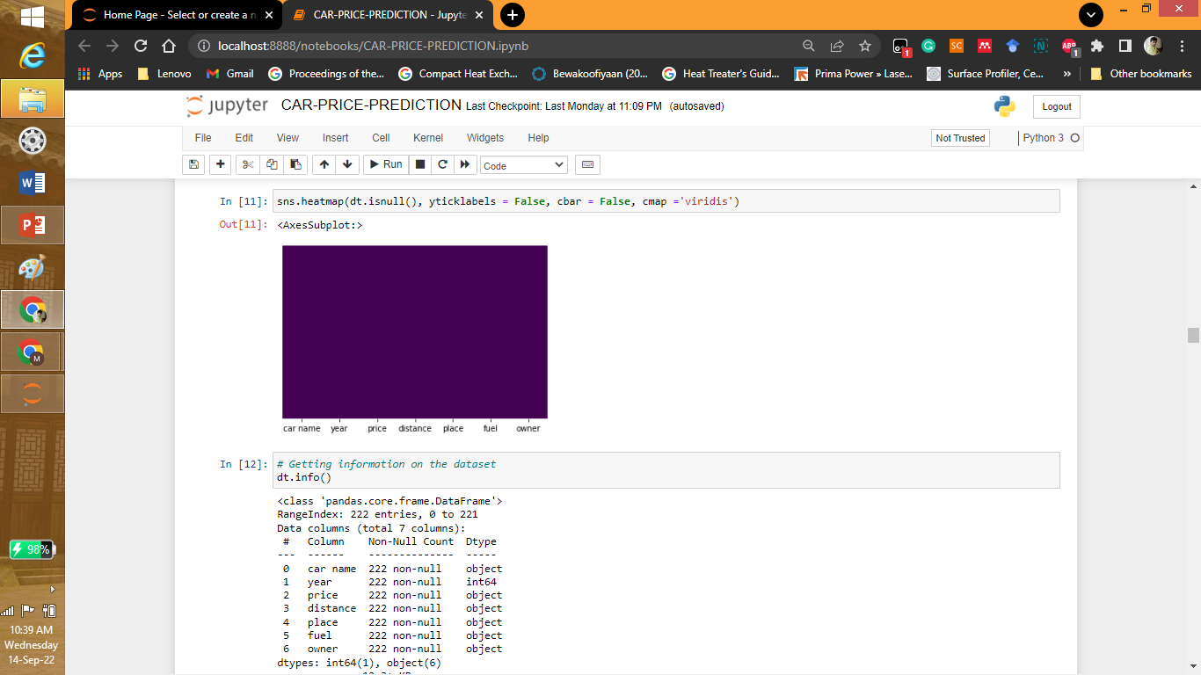
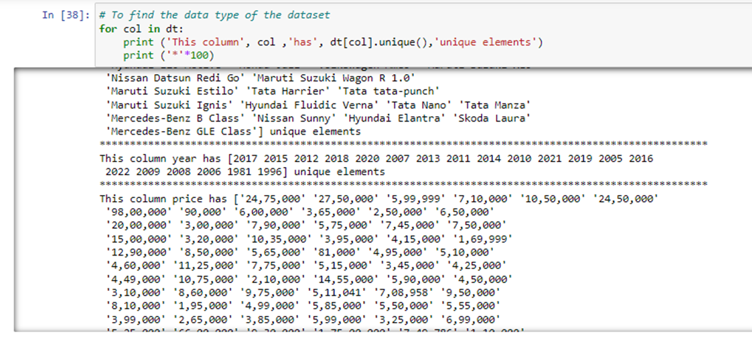
Analysis of Dataset

Slide 13
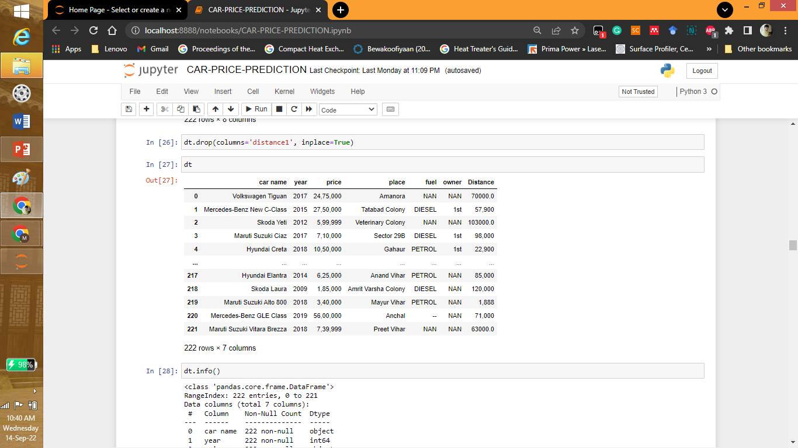
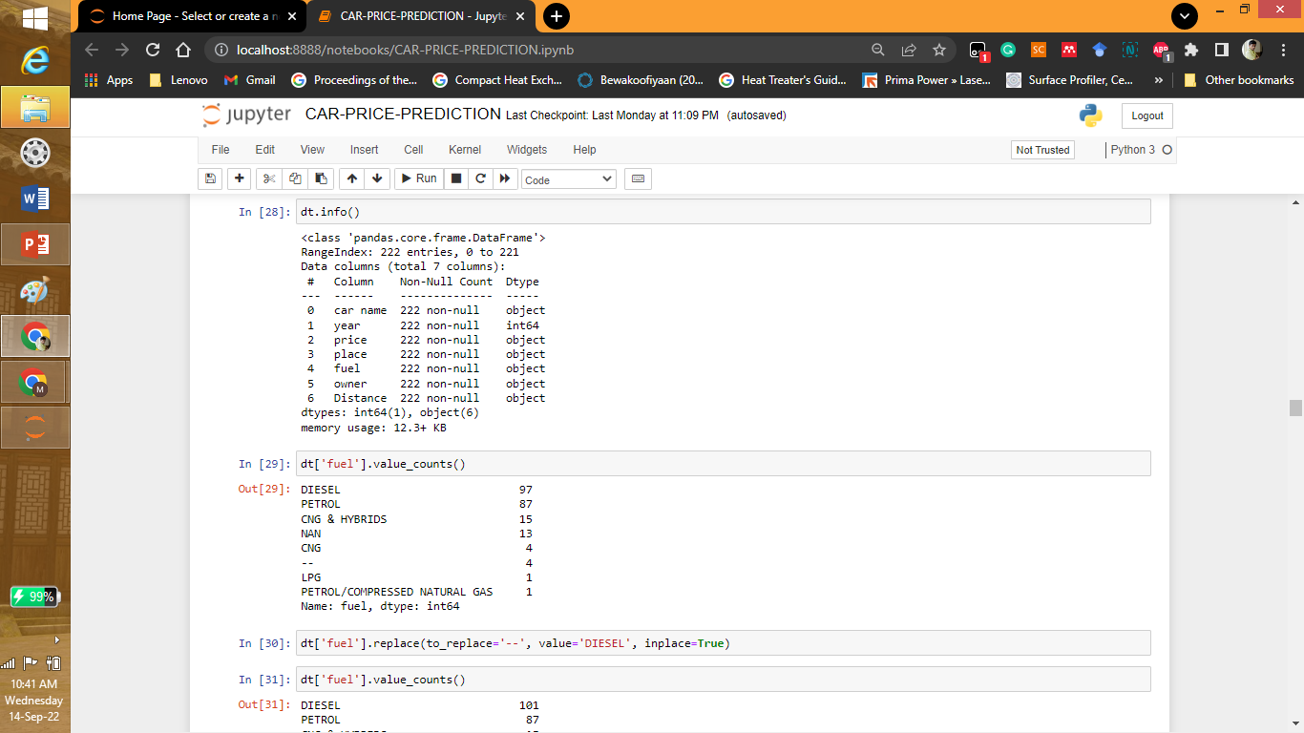
Analysis of Dataset

Slide 14
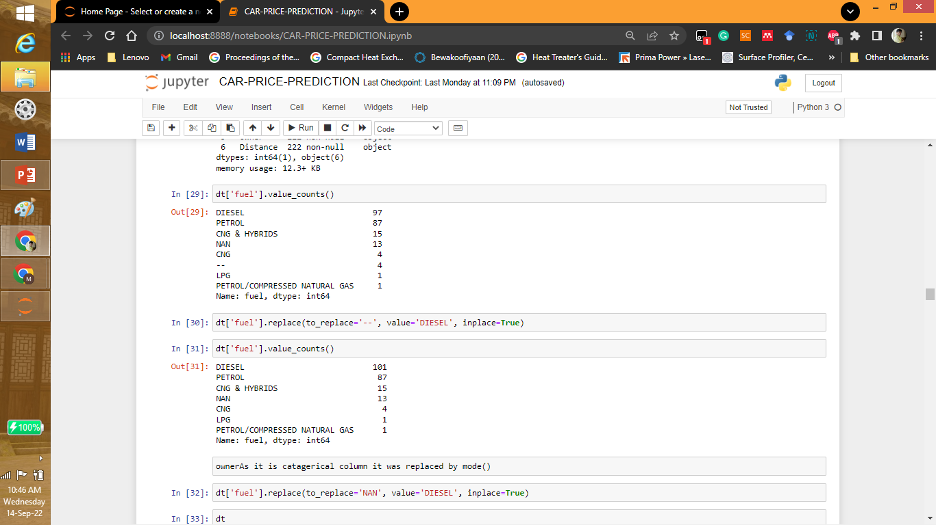
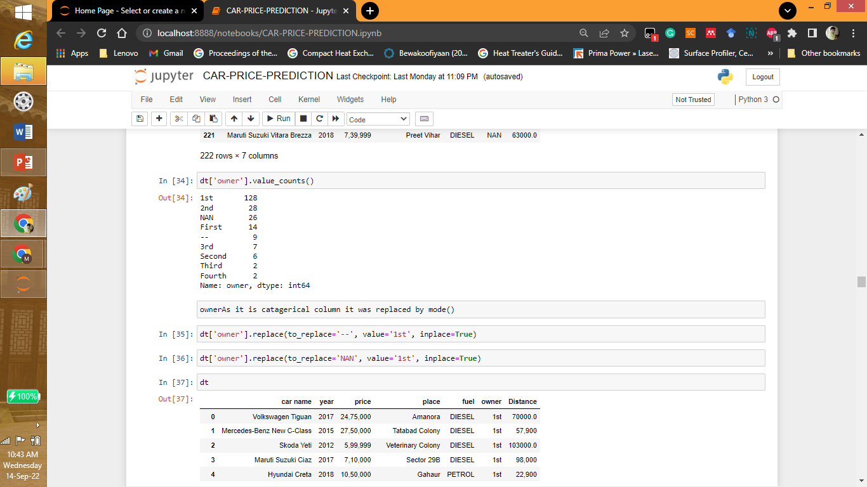

Slide 15
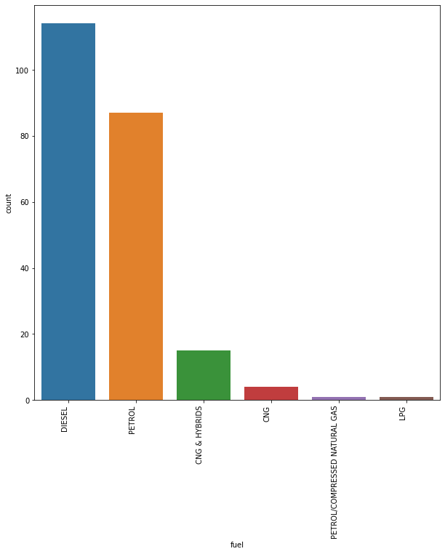

Slide 16
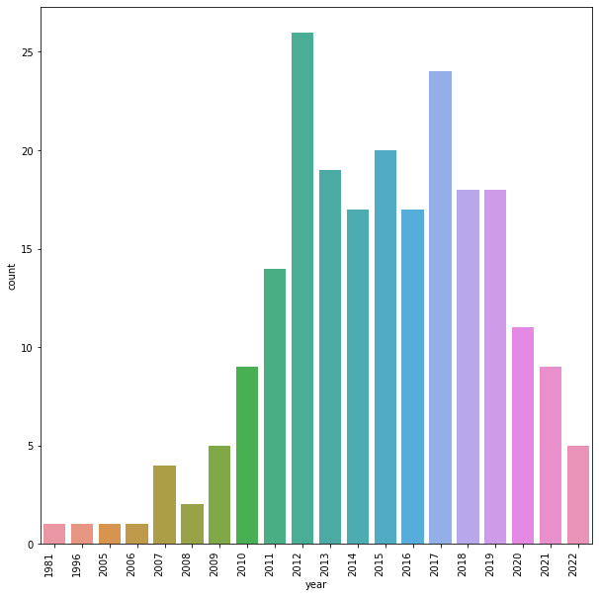

Slide 17
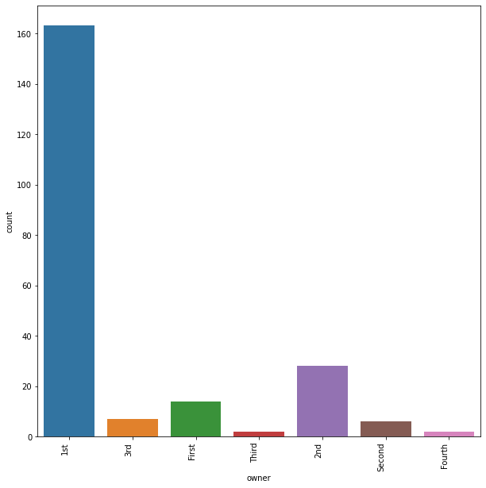

Slide 18
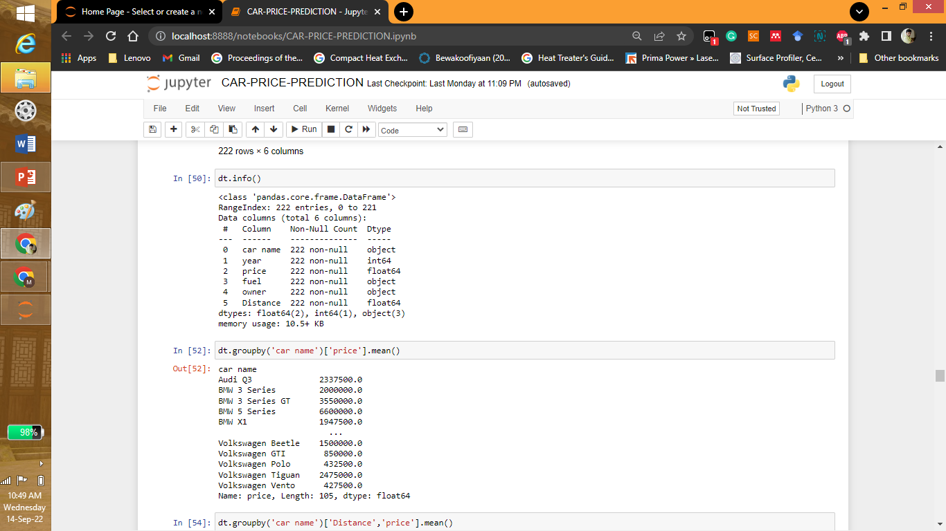
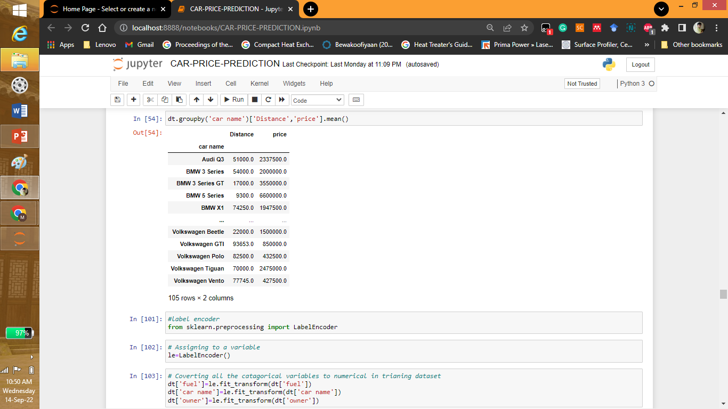

Slide 19
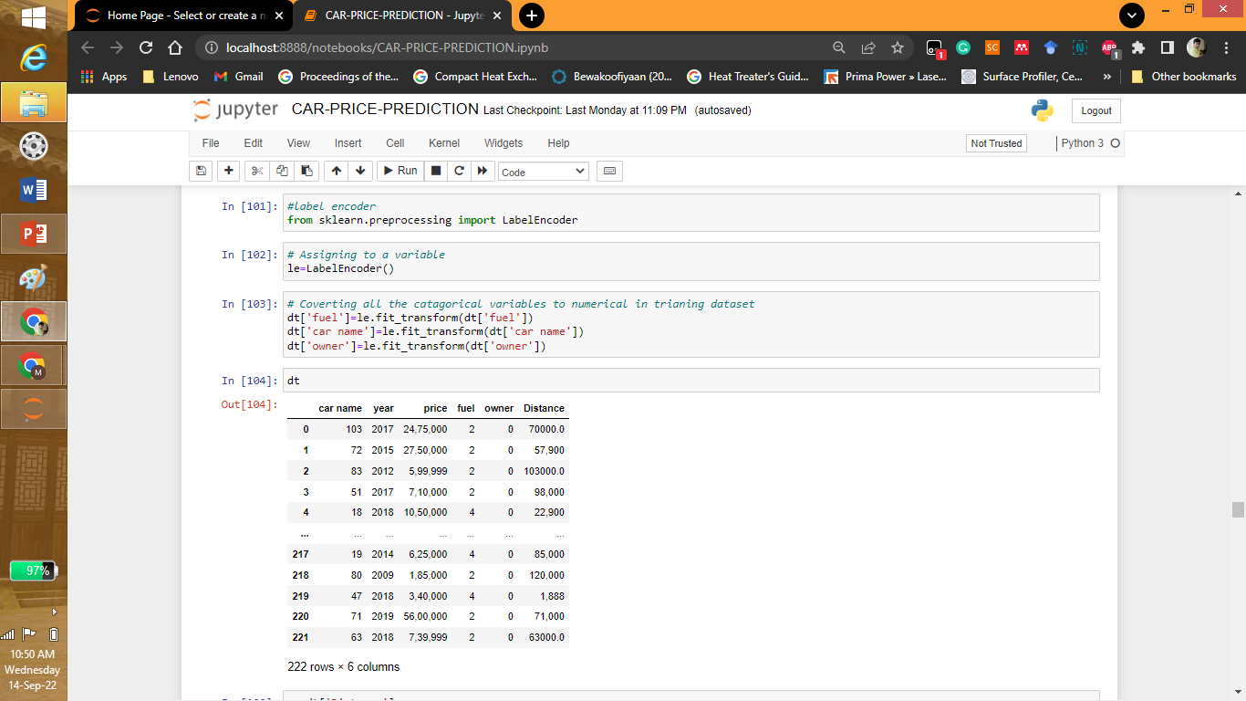
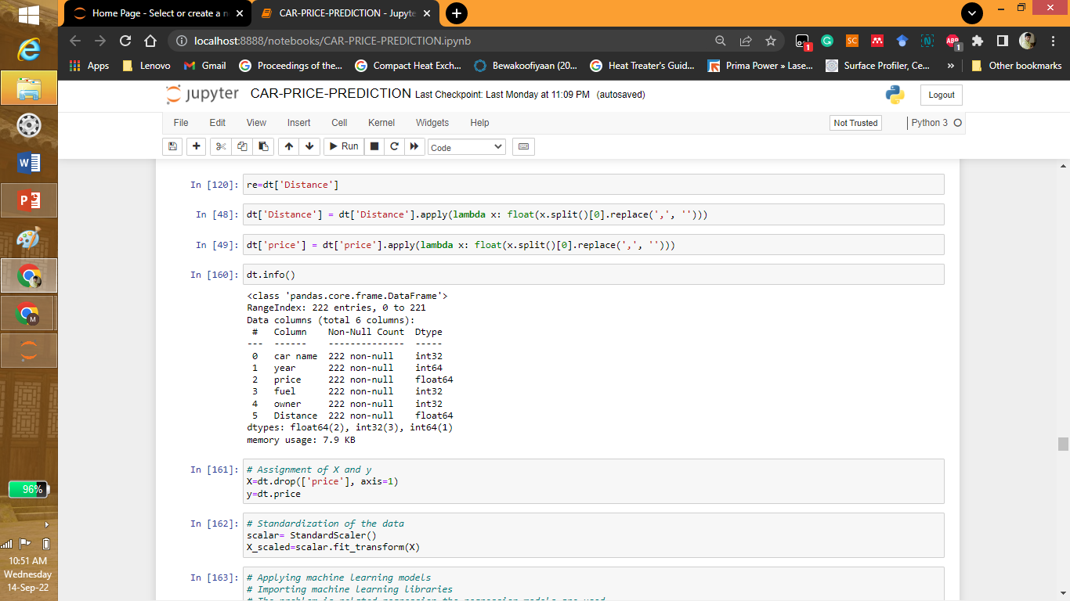

Slide 20
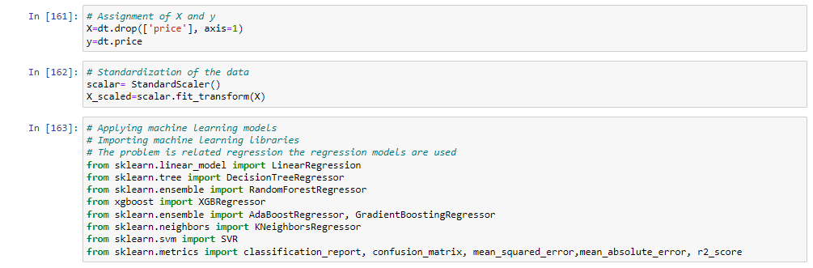
Machine Learning Model

Slide 21
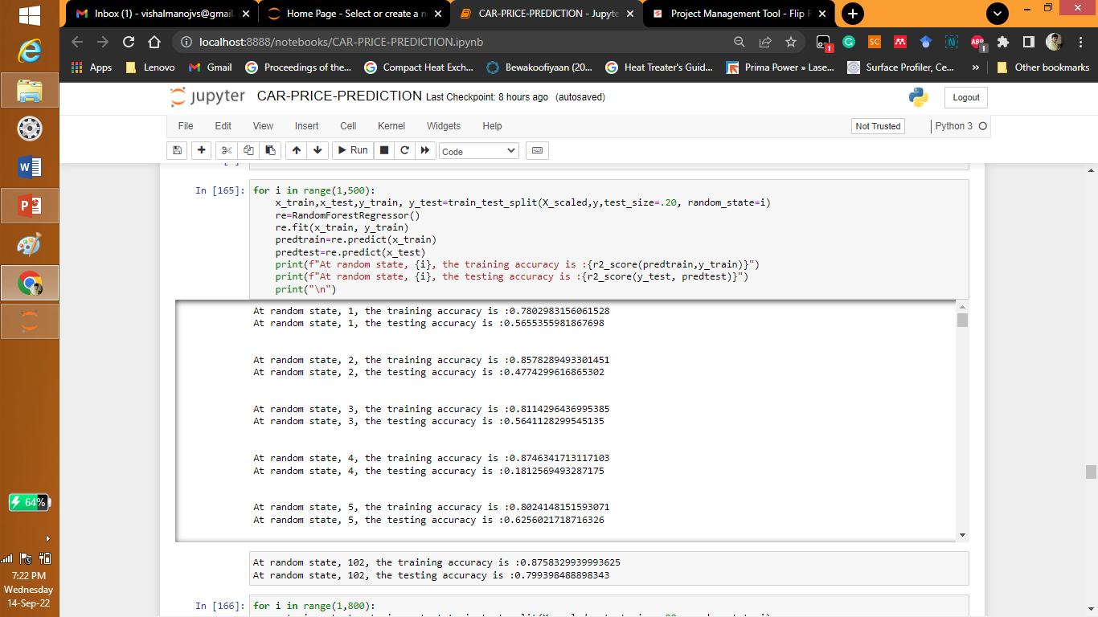
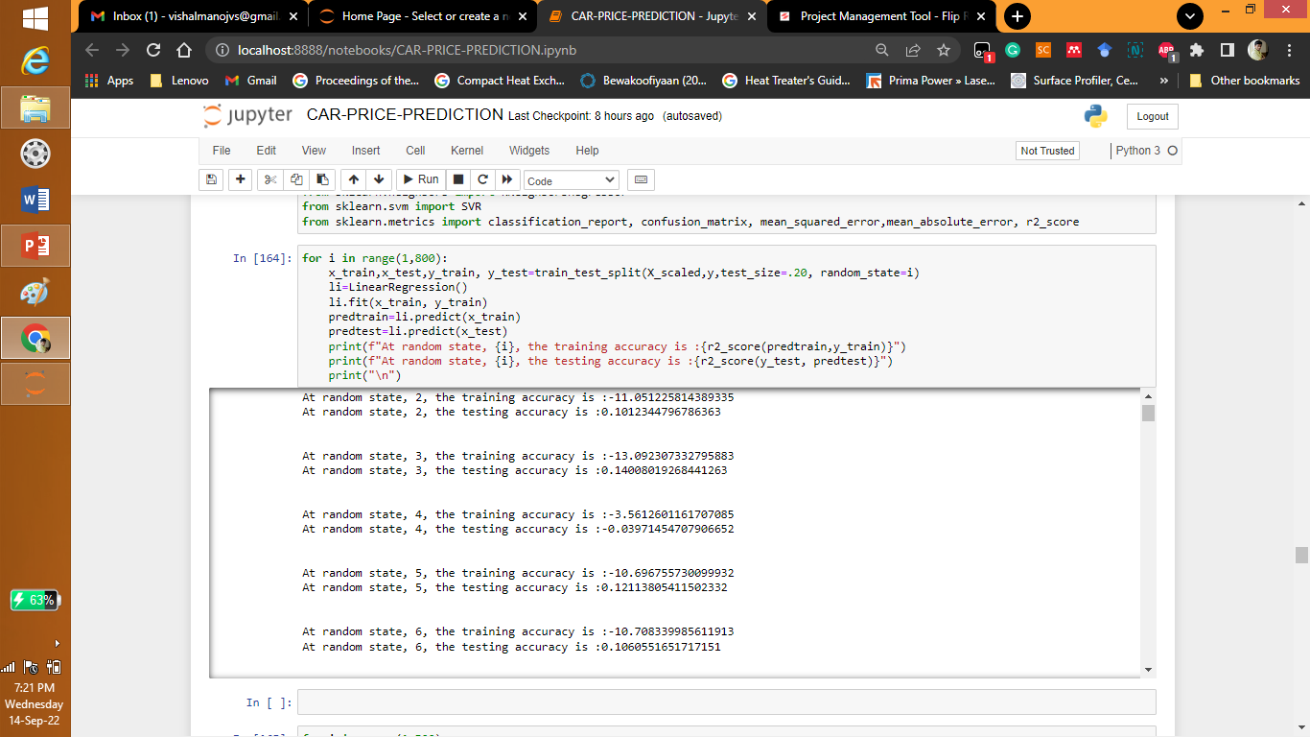
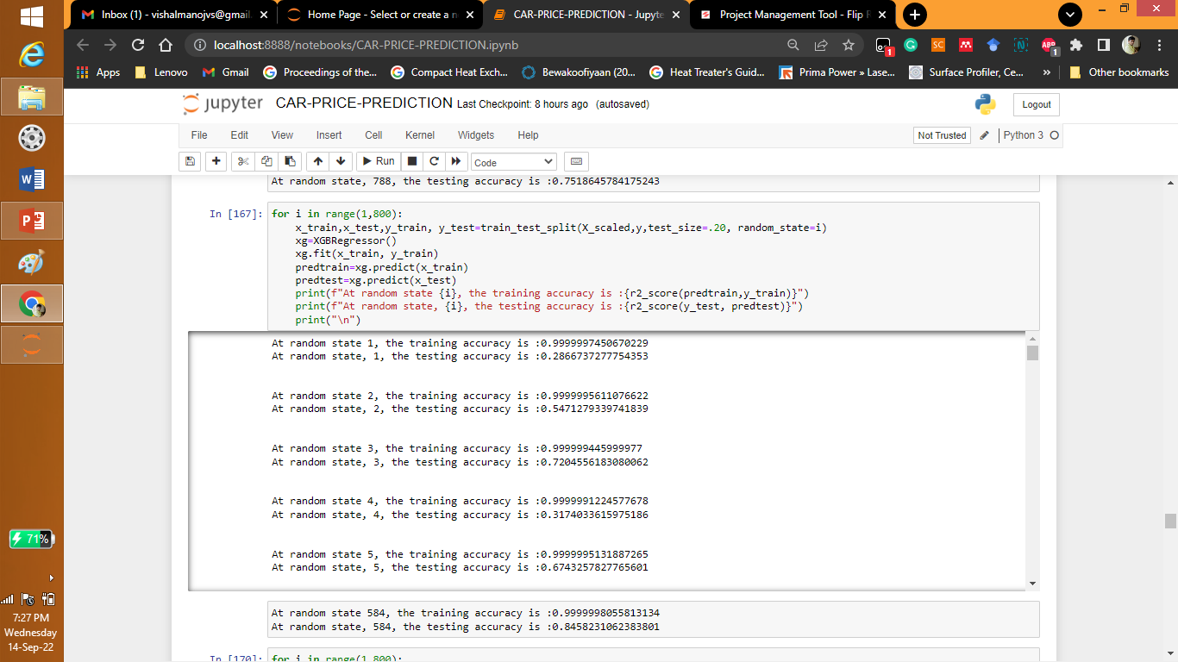
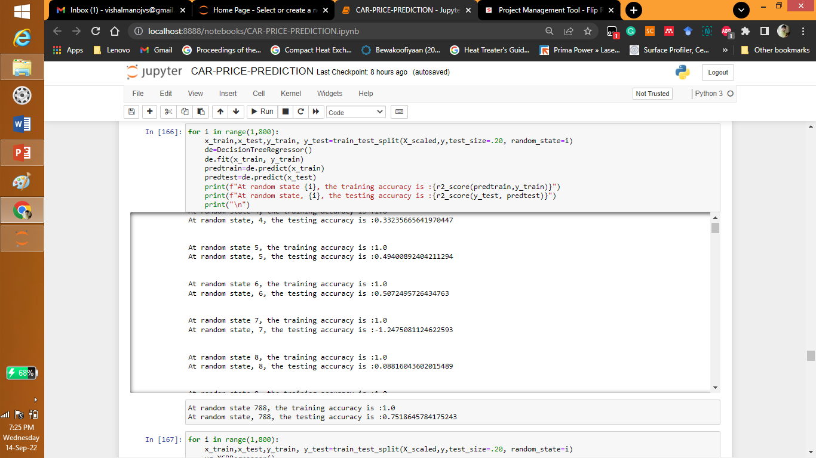
Machine learning Models

Slide 22

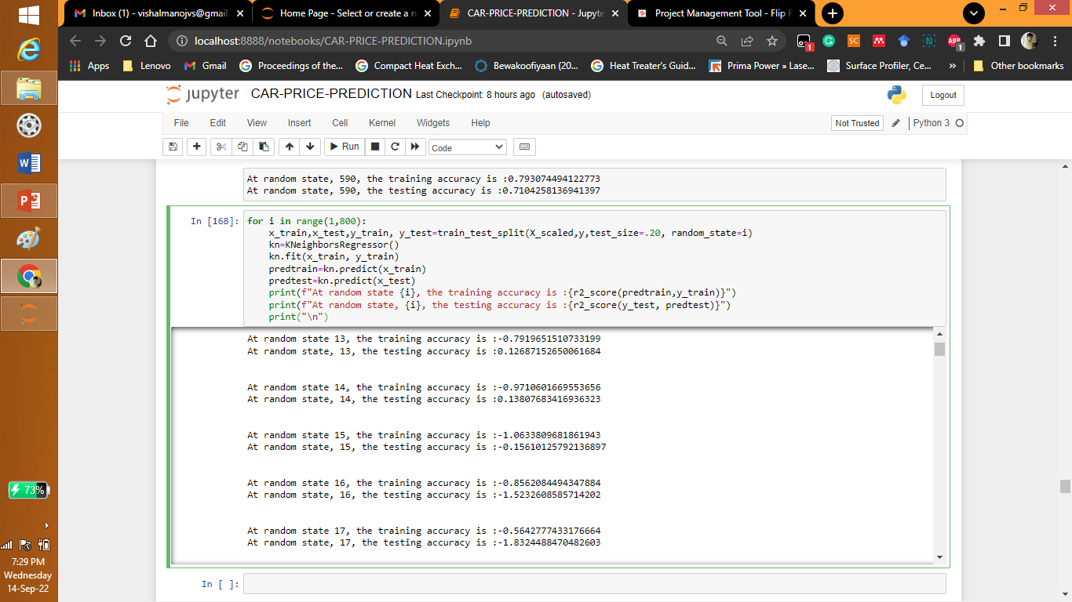
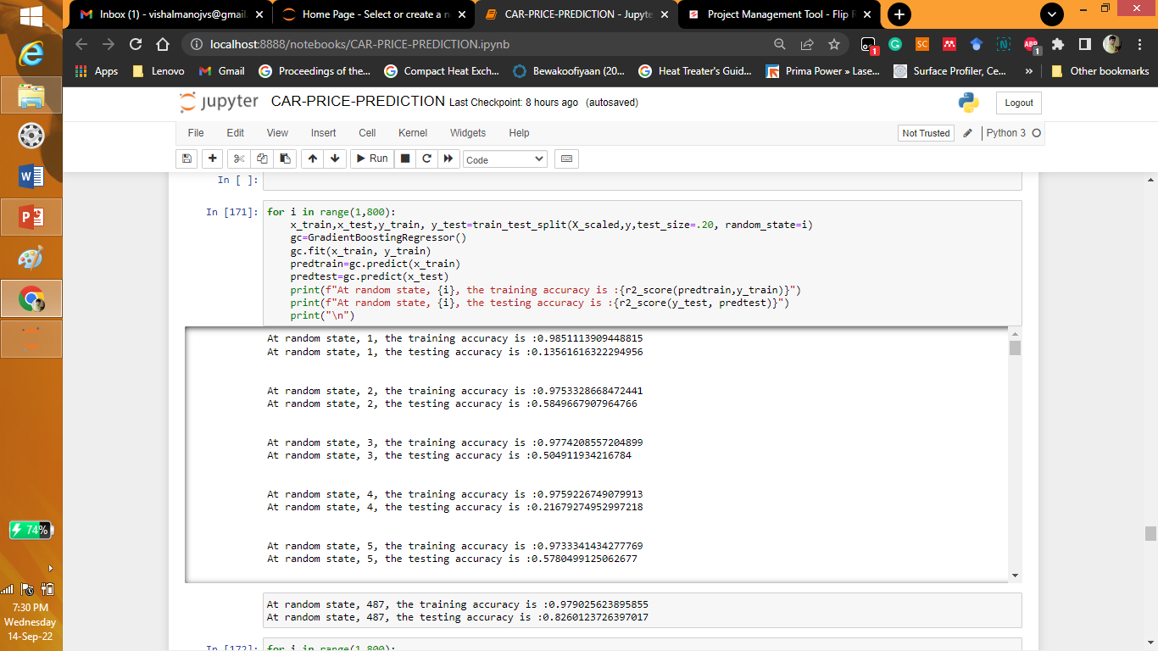

Machine learning Models

Slide 23
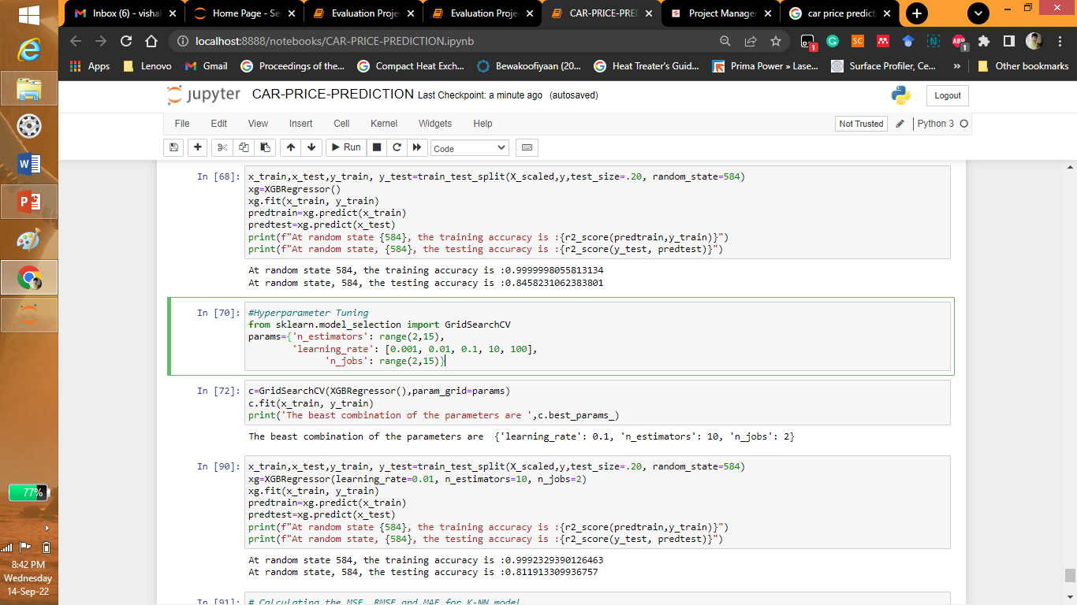
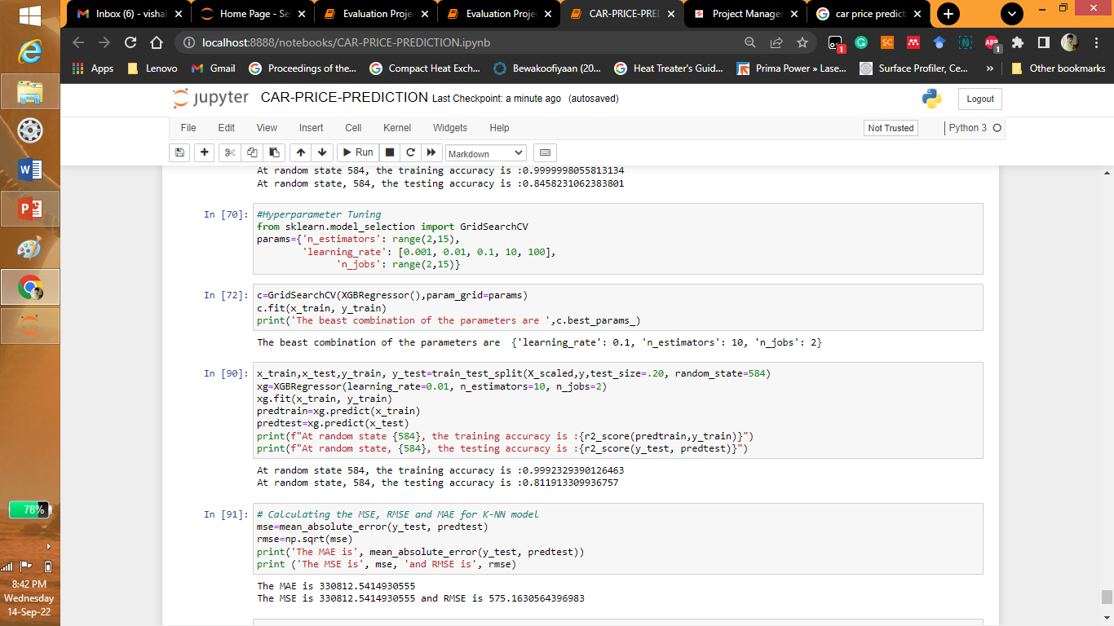
Machine learning Models

Slide 24
Conclusions
We can see that 2012 and 2017 manufactured vehicles, 1st owner vehicles and diesel fuel are for sales.
It can be seen the model was webscrapped. Then it was made as a dataset which was used for modelling. The data is cleaned and the different graphs were plotted for explorative data analysis. Then the label encoder is used and catagorical variables were converted to numerical format. Different model were used and XgBoost model was seen to be most efficient. After hyperparameter tuning is at random state 584, the training accuracy is :0.9992329390126463. At random state, 584, the testing accuracy is :0.811913309936757
More data can be scrapped and applied for prediction. The solution provided only has the accuracy of 81% approximately by using neural networks this accuracy can be increased.

